Slide 1
Analyzing and monitoring daily automobile sales in all areas to improve their business
ADTA 5340
Instructor: Dr. Schentia Floyd
Project Presentation by Group 4
Arun Kumar Maram
Devika Vadlamudi
Harish Kumar Yamsani
Phani Kumar Kandepi
Sindhu Priya Keshireddy
Surya Teja Goud Keesara
Venkat Sai VallalaVenkat
Notes:
<a href='https://www.freepik.com/vectors/data'>Data vector created by stories - www.freepik.com</a>

Slide 2
Overview
01
Introduction of the use case
02
What is Data and Data Lifecycle
03
Components of the Data Lifecycle
04
Tools/Applications used
05
Questions
Notes:
https://www.freepik.com/free-vector/checklist-concept-illustration_5573507.htm#page=2&position=27

Slide 3
Use case
Our use case is to provide data required to analyze and monitor daily automobile sales in all areas to improve Bear Motor Inc. Data engineers typically deal with data generation, collection, processing, storage, and management. Analysis, visualization, and interpretation will handle by the data analyst team.
Notes:
<a href='https://www.freepik.com/vectors/business'>Business vector created by stories - www.freepik.com</a>

Slide 4
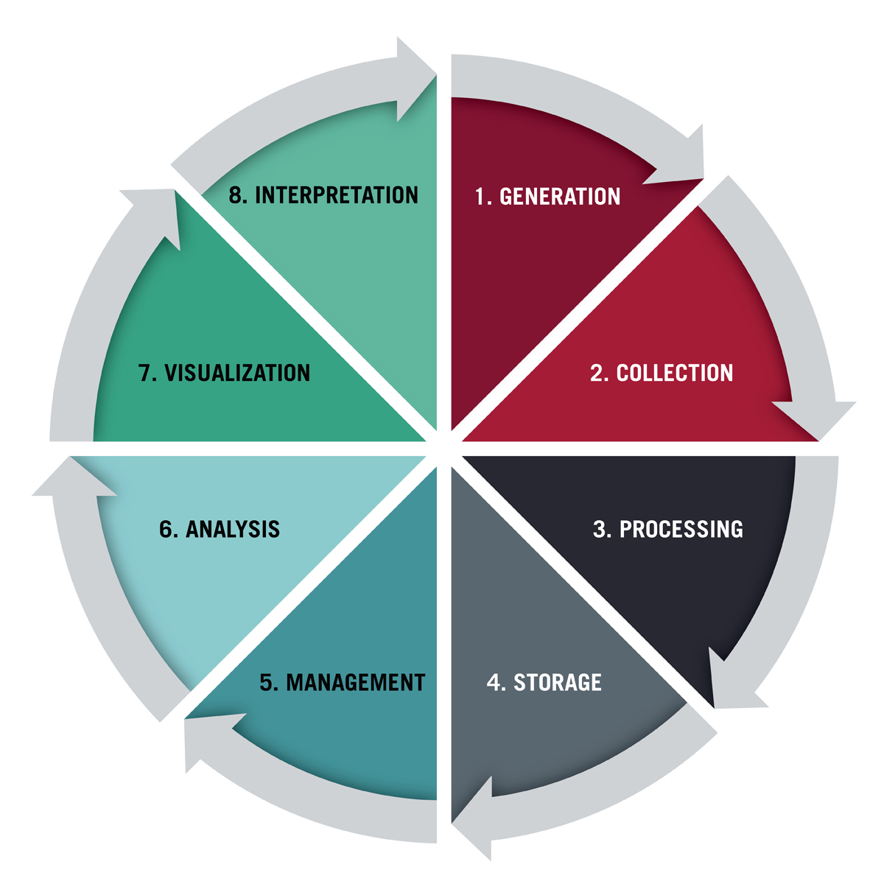
What is Data and Data Lifecycle
Data is information, such as facts and numbers used to analyze something or make decisions.
Each data project brings its challenges, opportunities, and potential solutions that impact its trajectory. Typically, all data projects follow the same basic lifecycle from start to finish. The data life cycle gives a broad overview of the steps necessary to handle big data for usage and reuse. It involves 8 phases.
Source: https://www.vocabulary.com/dictionary/data; https://online.hbs.edu/blog/post/data-life-cycle

Slide 5
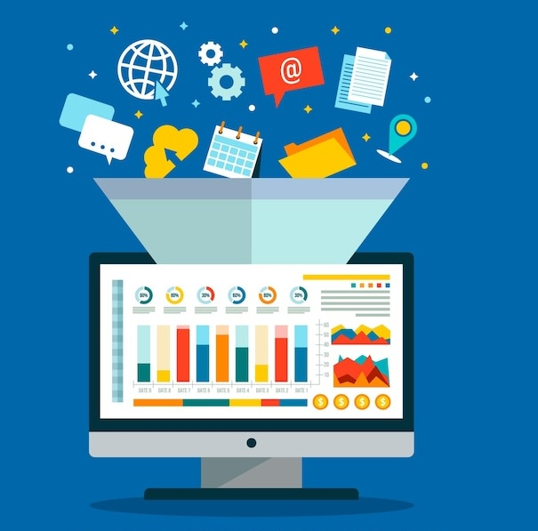
Generation
Data generation is the first phase of the data lifecycle. Without data being generated, other steps cannot start.
We have used one static dataset from the United States Environmental Protection Agency that provides information about various car models along with the manufacturer name, year of manufacturing, MPG, Horsepower, Acceleration, etc.
We have collected streaming data from Twitter using API. This data includes hashtags, descriptions, text, images, etc.
Source: https://online.hbs.edu/blog/post/data-life-cycle

Slide 6


Collection & Processing-Static Dataset
The data collection strategy depends on the organization's needs, and not all generated data is collected.
For our use case, we have used a static dataset called Detailed Automotive Trends Data from the US EPA website.
The dataset we have used contains 5170 entries and 54 columns. A majority of the variables contain null values. We have cleansed 'Model Year' as it contains strings. Hence, we cleaned the data using OpenRefine and imported it into the GCP platform.
Source: https://online.hbs.edu/blog/post/data-life-cycle; This Photo by Unknown Author is licensed under CC BY-NC

Slide 7
Collection & Processing-Streaming Dataset
Typically, business brands consistently monitor Social Media for various reasons, like responding to customer service requests, analyzing market trends, etc.
This year in June, Twitter launched two API toolkits for Google Cloud that enables data processing automation. These tool kits ingest Tweets into BigQuery
Twitter API Toolkit for Google Cloud Filtered Stream
Twitter API Toolkit for Google Cloud Recent Search
Source: https://cloud.google.com/blog/products/data-analytics/twitter-api-toolkit-for-google-cloud

Slide 8
Collection & Processing-Streaming Dataset
Twitter data falls under the semi-structured category. When we fetch data few fields are stored in the format of nested and repeated data (like entities, geo). When we are writing a query we must first UNNEST them and then need to write the condition.
We can query data based on the search criteria and can export it into Google Sheets, or we can export it into a storage bucket.
We can visualize data directly from BigQuery with Data Studio if the data is clean.
Source: https://online.hbs.edu/blog/post/data-life-cycle

Slide 9
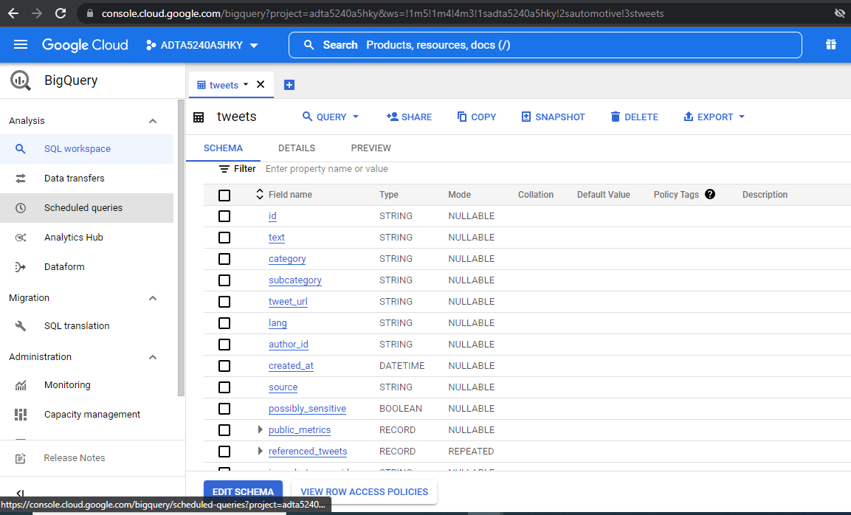
GCP Snapshot

Slide 10
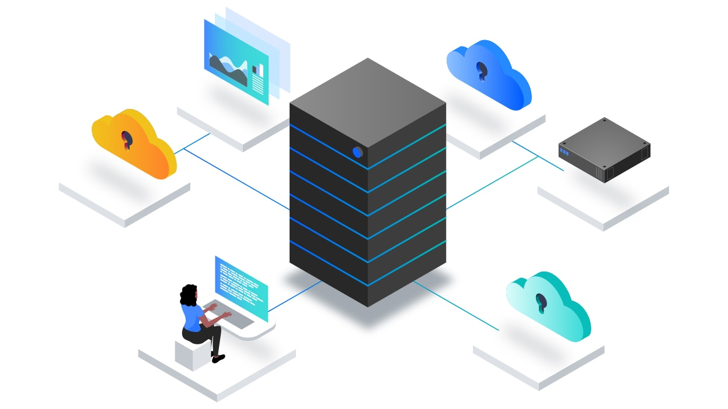
Storage & Management
After data processing, we imported the static data into the Google Cloud Platform.
For data management (also called database management) we have used RDBMS database models called BigQuery, Hive, and Spark. These will help us organize, storing, and retrieve data as necessary over the life of a data project.
Analysis and Visualization will be handled by our data analytics team.
Source: https://online.hbs.edu/blog/post/data-life-cycle; Image Source: URL

Slide 11





Tools/Application Used
Cleaning
Storage
RDBMS
Image Source: URL; URL; URL; URL; URL

Slide 12

Questions.!
Notes:
<a href='https://www.freepik.com/vectors/data'>Data vector created by stories - www.freepik.com</a>

Slide 13

Thank you.!
Notes:
https://www.freepik.com/free-vector/checklist-concept-illustration_5573507.htm#page=2&position=27

